Slide 1


CONNECTTEL CUSTOMER CHURN PREDICTION

Slide 2

Business objectives
To create a customer churn prediction system, aiming to minimize customer attrition, strengthen customer loyalty, and sustain a competitive advantage in the industry.

Slide 3

Benefits of a customer churn prediction system
Customer Retention Strategy Improvement
Enhanced Customer Loyalty
Resource Optimization
Competitive Advantage

Slide 4
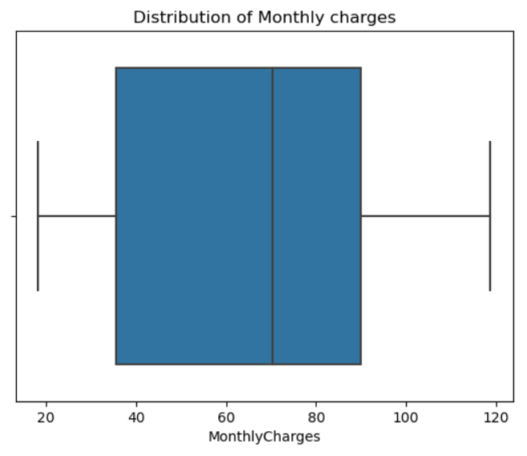
Exploratory Data Analysis (Univariate Analysis)
Monthly charges Analysis
The Monthly Charges feature shows no outliers, with 50% of its data distributed between 35.5 and 89.9. It has a median of 70.4 and exhibits a left-skewed distribution.

Slide 5
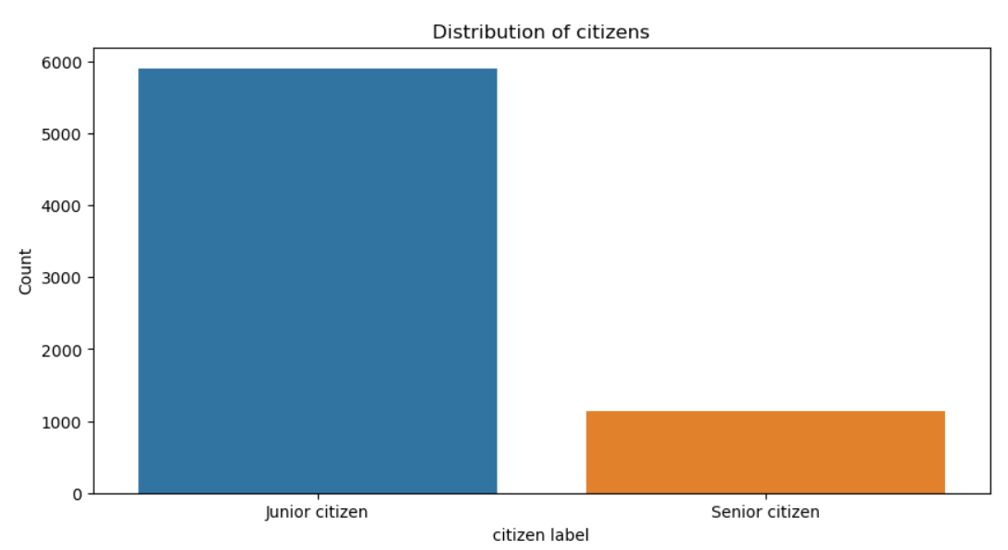
Exploratory Data Analysis (Univariate Analysis)
Citizen Feature Analysis.
The data shows that the majority of the customers are junior citizens and just a few are senior citizens.

Slide 6
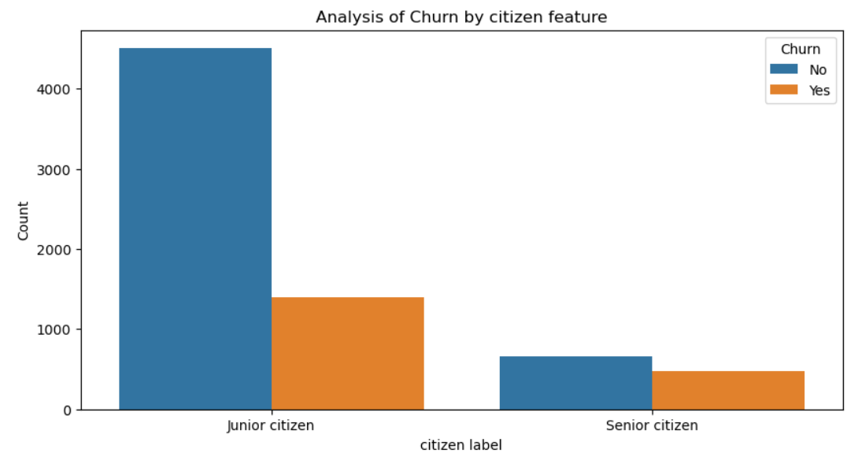
Exploratory Data Analysis (Bivariate Analysis)
Analysis of Churn by the Citizen feature.
The junior citizen class has about 25% of its population churning while the churn rate is even higher in the senior citizen class with about 80% churn rate.

Slide 7
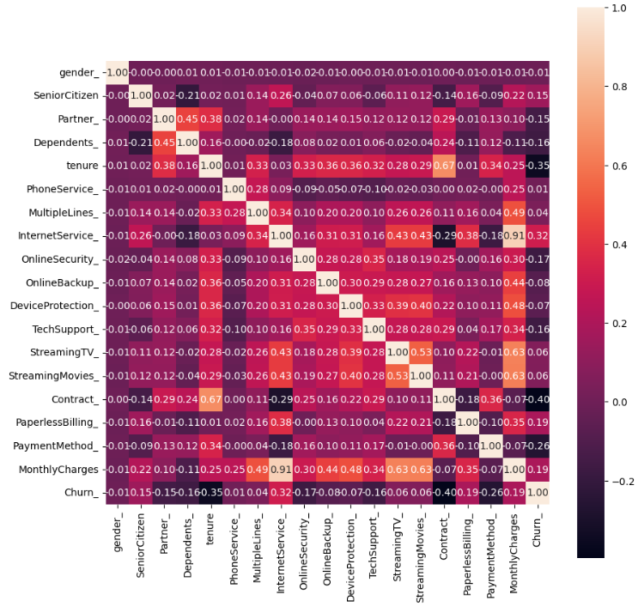
Correlation Matrix
Negative correlations
Payment method and churn.
Contract and churn.
Tenure and churn.
Positive correlations
Internet service and Churn

Slide 8

Data Preprocessing steps
Feature Engineering: The target label was separated, and the redundant variables were dropped. Also, columns with wrong data types were changed.
Label Encoding: Each category was assigned a unique numerical label.
Scaling: The Standard scaler was used to scale the dataset.

Slide 9

Model Building and Evaluation
The data was split into 70% train and 30% test
The top 3 models based on Recall are:
Naive Bayes(optimized) – 81.1%
Logistic Regression – 54.8%
Decision Tree classifier – 52.4%
Model determining metric: Recall Score
A model with a high recall score means it is good at identifying all instances of churn while minimizing false negatives, as missing churn cases could lead to customer loss.

Slide 10
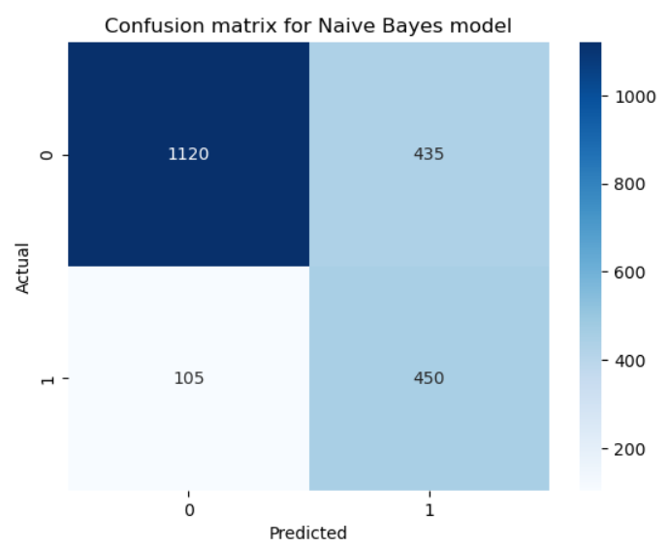
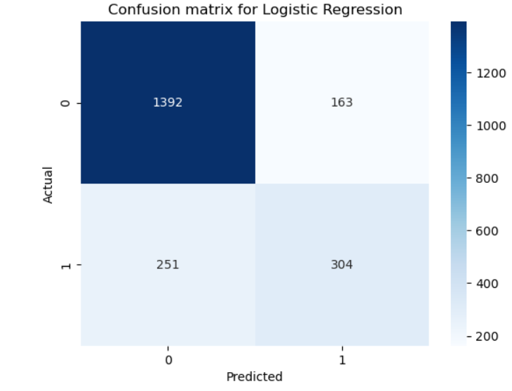
Model Evaluation (Confusion Matrix)
Naive Bayes
True Positives: 450
False Negatives: 105
Logistic Regression
True Positives: 304
False Negatives: 251

Slide 11

Conclusion
Considering the business objective, an ideal model should prioritize predicting low false negatives and high true positives. This is crucial as a high number of false negatives may lead to missing churn cases, resulting in potential customer loss.
Despite having a higher count of false positive predictions compared to logistic regression, the associated cost in this context is deemed lower than the potential cost of handling false negatives. Consequently, the Naive Bayes model is selected as the optimal choice.

Slide 12

THANK YOU!

